Slide 1



Analysis By:
Shreenidhi Sriram
MKT 6352.0W1 - Marketing Web Analytics and Insights - S23

Slide 2


Our Agenda
Company Description
Key business objectives
KPI1 : Traffic Analysis and Recommendations
KPI2 : Conversion analysis and Recommendations
KPI3 : Returning analysis and Recommendations
Conclusion
KPIs can help Target measure the success of its ecommerce platform and identify areas for improvement, such as website optimization, marketing campaigns, and customer retention strategies

Slide 3






About the Company
Target is a well-known American retail corporation that was founded in 1902.
It is headquartered in Minneapolis, Minnesota, and has more than 1,900 stores across the United States.
In addition to its brick-and-mortar stores, Target also operates an online ecommerce platform.
Target's ecommerce platform allows customers to purchase products online and have them delivered to their doorstep or picked up in-store.
The company offers a wide range of products, including clothing, electronics, furniture, beauty products, and groceries.
Customers can also enjoy a variety of services on the platform, such as free shipping, same-day delivery, and easy returns.

Slide 4



MISSION​: To make shopping easier, faster and more rewarding for guests
OBJECTIVE: To provide a wide assortment of high quality, affordable products and excellent customer service.
VISION: To be America's favorite store for everyday essentials and affordable luxury.
Business Objectives
Drive sales and revenue
Increasing brand awareness
• Improving customer loyalty

Slide 5
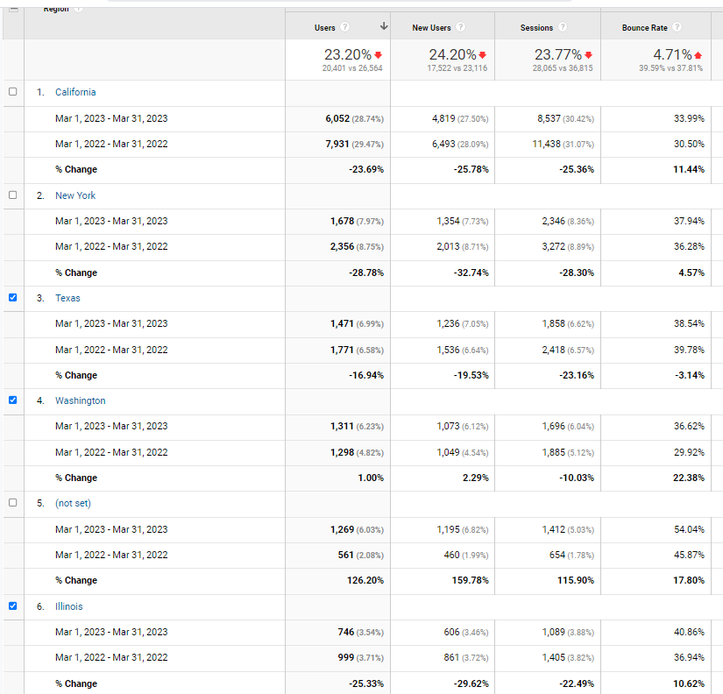
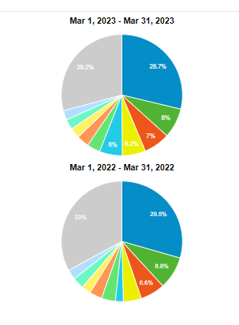

Case 1 : Traffic Analysis
The objective is to examine the primary areas(regions in USA), platforms (channels), and devices that are driving traffic and have the potential to attract new users. Additionally, the aim is to propose strategies to increase traffic in underperforming regions, channels, and devices.
TimeLine : March 2022 vs March 2023
The performance of the key metrics indicates that the USA is not a market with growth potential. Major states have decreased users, and the metrics have decreased compared to 2022.

Slide 6
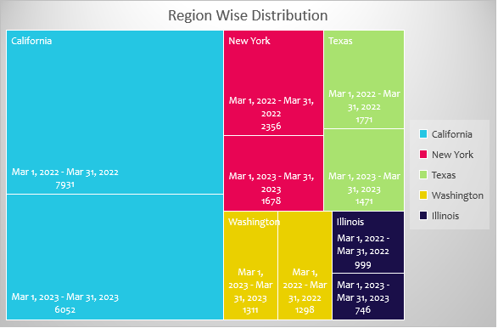

Region Wise Traffic Analysis
Insights : For Top 5 User Base Regions
California had the largest user base, it experienced a decrease of 23.69% in 2023.
On the other hand we can see that Washington has observed a upward trend in the form of users 1% and new users 2.24%, but a decrease in sessions by 10.03%.
For other major regions like New York, Texas, Illinois, California we observe a downward trend in the user count, so we can say our strategies in these regions did not work and we can implement what Washington used for high acquisition.

Slide 7
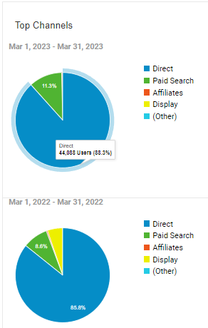
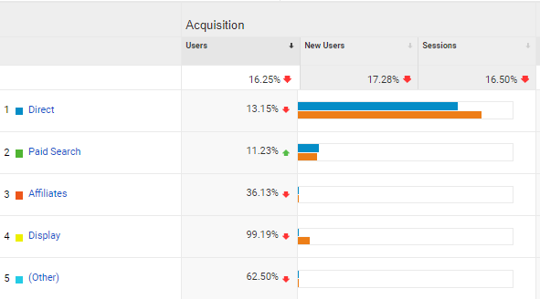

Channel Wise Traffic Analysis
Insights
In 2023 ,we see a significant decrease of 16.25% of the users (50,765 vs 44,088).
The majority of users accessed Target in 2023 by directly entering the website address or using a bookmark, which constituted 88.31% of the total users who visited via the Direct Channel.
We can see that the users significantly dropped from 5.24% to 0.05% for the display channel.

Slide 8
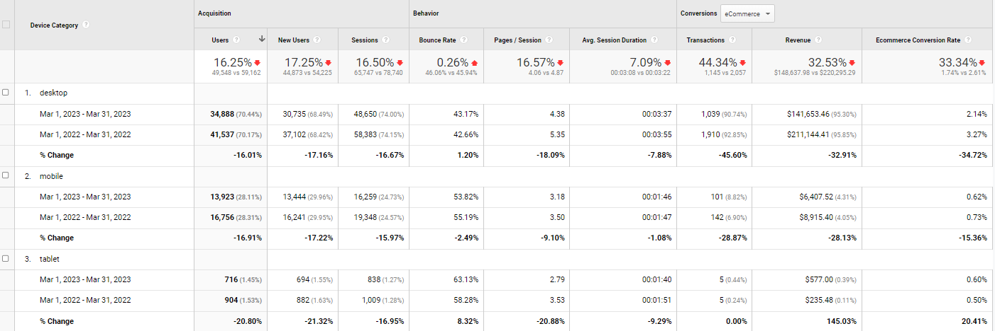
Device Wise Traffic Analysis
Insights
Major users in USA use Desktop to access the website for both 2022 and 2023.
Total sessions decreased by 16.50 % in 2023.
The bounce rate has observed a drop of 0.26%, with tablets experiencing the highest increase of 8.32% in Tablets and 1.20 % in Desktop. This indicates that a larger number of users were not engaging with the website when accessing it through their tablet device.

Slide 9


Recommendations (Traffic Analysis)
Given that the majority of our traffic originates from desktops, we should prioritize enhancing the UI/UX of our website's desktop version.
To reinforce the visibility of our search engine, we should consider using Google AdWords and PPC ads. Additionally, we can retarget visitors to the Target website through these ads.
Placing ads on websites that have a high number of visitors, relevant content, and are likely to attract the target audience for display channel.
To improve stats in Low Acquisitions areas and other major regions, we can tie up with Washington based influencer and do a paid campaign with them to attract more traffic in New York, California.

Slide 10

Case 2 : Conversion Analysis
The goal is to examine the regions that have the highest and lowest conversion rates, identify where users are dropping off in the conversion process, and recommend strategies to improve this. Additionally, we should determine the percentage of loyal customers and enhance their experience to increase their Customer Lifetime Value (CLV).
TimeLine : March 2022 vs March 2023

Slide 11
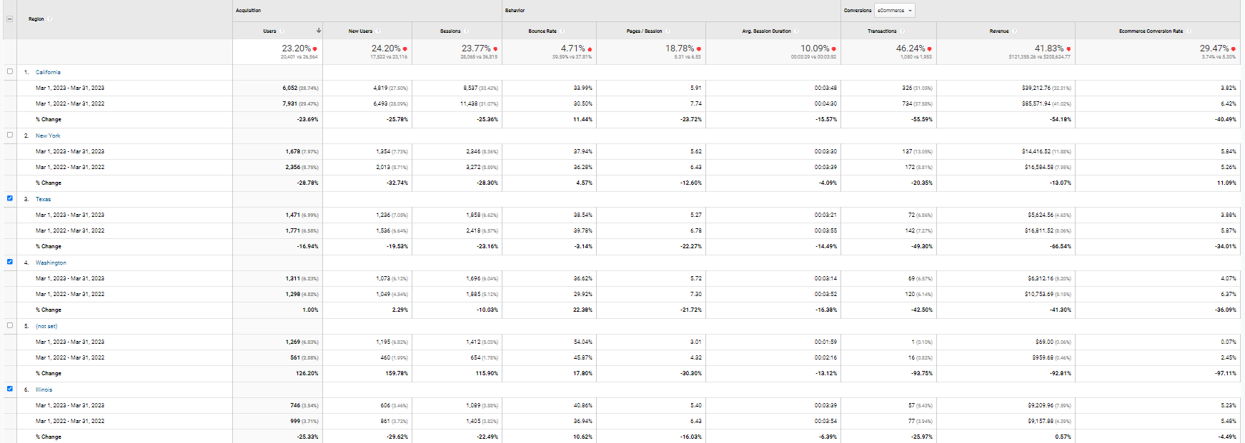
Case 2 : Conversion Analysis
TimeLine : March 2022 vs March 2023
As seen in the data of 2022 and 2023, there is a clear decrease in the revenue 41.83% and conversion rate 29.47% around the different states of USA in 2023 as compared to 2022:
• In California, the revenue has decreased by whooping 54.18% while, the conversion rate has also decreased by 40.49%.
• In New York, there was a decrease in the revenue by 13.07% while the conversion rate has decreased by 11.09%.
• In Texas revenue has decreased by 66.54% while the conversion rate has decreased by 34.01%.
• In Washington revenue has decreased by 41.30% while the conversion rate has decreased by 36.09%.
• In Illinois, there has been an increase in the revenue by 0.57% and conversion rate decreased by 4.49%.

Slide 12
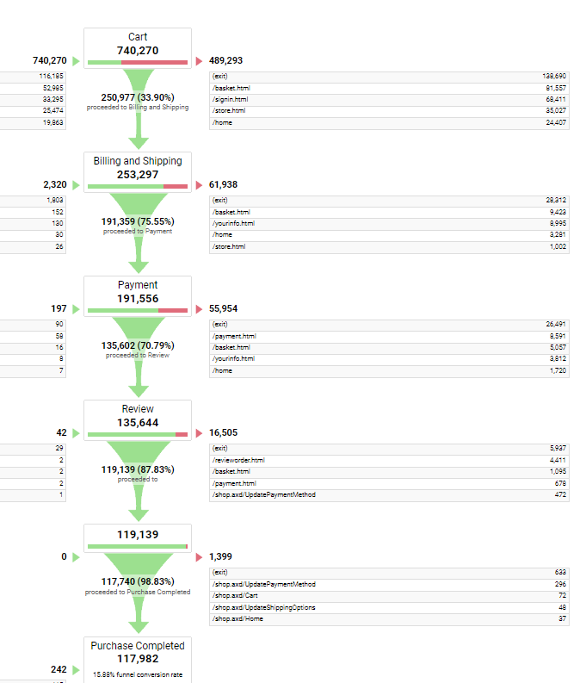
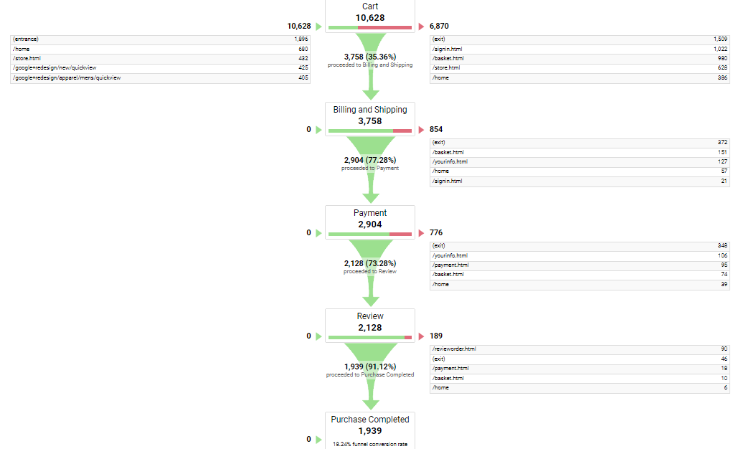
Case 2 : Conversion Analysis
User Drop Offs
As seen on the Goals Funnel, the cart additions have increased to 35.36% in March 2023 compared to March 2022 33.90%.
However, in March 2023, 77.28% users proceeded to complete their purchase compared to 75.55% in March 2022.
The drop at Review has been huge in 2023 indicate that people are changing mind.
Only 91.12% people have completed the purchase in 2023 as compared to 98.83% in 2022.
2023
2022

Slide 13
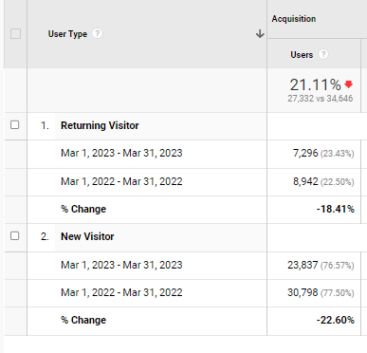
Case 2 : Conversion Analysis
Returning User Analysis
We see that the overall users have decreased by 21.11 % for returning and new visitors in 2023 as compared to 2022.
The revenue from returning visitors has decreased by 40.51% in 2023.
The revenue from returning visitors has decreased by 31.95% in 2023.

Slide 14

Recommendations (Conversion Analysis)
To enhance user experience and boost conversions, it is important to audit and optimize website page speeds, as slow loading times can result in lost conversions.
Additionally, sharing social media content that prompts impulse purchases can drive more sales.
Addressing high shipping rates or long delivery times at the billing and shipping page can help prevent client loss.
Similarly, improving the payments page by offering cashback options can incentivize customers to place orders.
To attract new users, Target could offer introductory discounts and promotions.
Additionally, implementing loyalty programs can help retain existing customers and encourage repeat purchases.

Slide 15

Case 3 : Behavior Analysis
Target aims to increase customer engagement and conversions by analyzing their interactions on the website and providing recommendations to enhance the overall experience.
This can be achieved by implementing personalized product stories, which can create a deeper connection between the brand and its consumers.
By understanding their preferences and behaviors, Target can tailor its messaging and promotions to better engage customers and drive interest in their unique products
The bounce rate for the US has increased by 4.71% from 2022 to 2023, indicating that visitors may be having difficulty finding what they are looking for on the website, or the site may not be tailored to their needs.
Across all regions, the page/session and average session duration have both decreased by 18.78% and 10.09%, respectively.
In light of these findings, it would be prudent to shift our focus towards improving conversion rates and turning website visits into purchases.

Slide 16
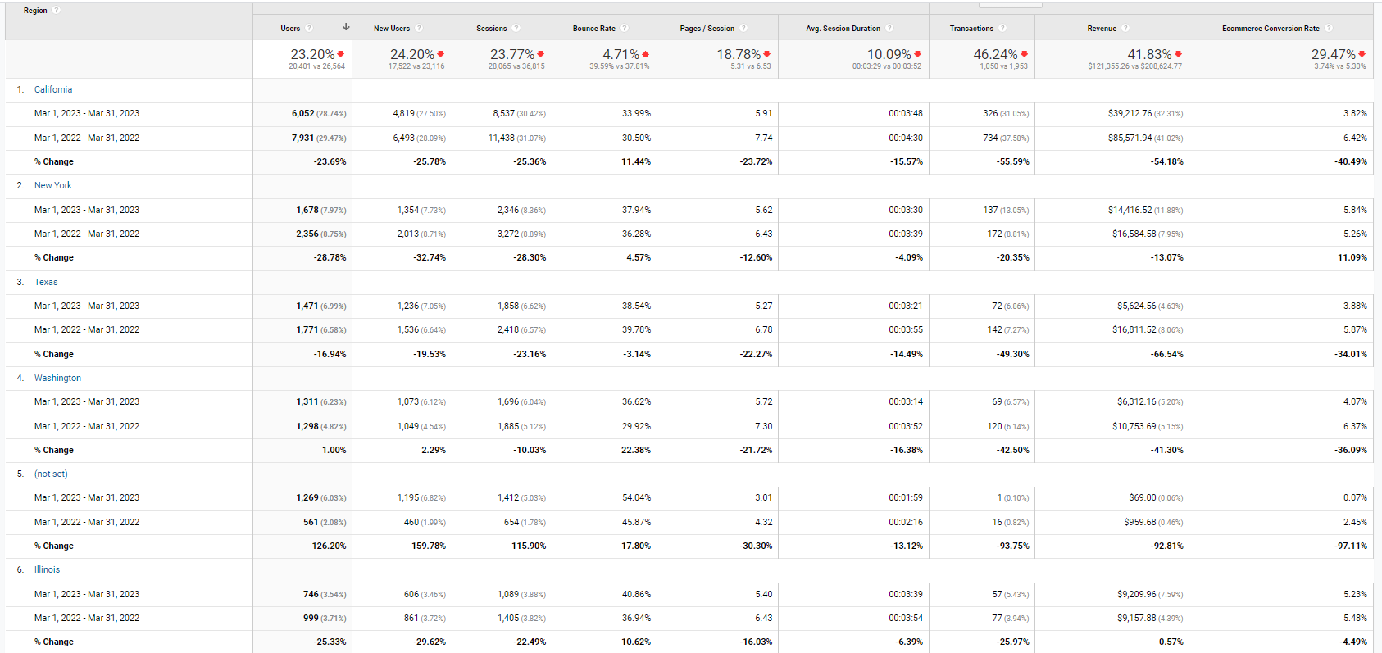
Case 3 : Behavior Analysis
For the regions having most users have positive bounce rate. (eg: New York-4.57%, California – 11.44%, Texas has drop of 3.14% indicates that visitors are engaging with the website and viewing multiple pages.
For the regions having most users, pages/session has declined ( New York-12.60%, California – 23.72%, Texas 22.72%) means that visitors are viewing fewer pages on average during each session on the website. This could indicate that they are not finding the content they are looking for or that the website is not engaging enough to keep them browsing.
For the regions having most users, average session duration has declined ( New York- 4.09%, California – 15.57%, Texas 14.49%) this could indicate that they are not able to find the information or products they are looking for or that the website is not sufficiently interesting or user-friendly to keep them engaged.

Slide 17


Large image
Recommendations (Behavior Analysis)
To enhance the effectiveness of social media posts, it's recommended to direct viewers to a specific product or category that aligns with the platform's audience.
Additionally, offering related product links and "frequently bought together" recommendations on the product page can encourage customers to explore more of the website and spend more time on it.
Moreover, adding personalized stories that describe the creator and the inspiration behind each product can create an emotional connection between the buyer and the seller, further increasing the appeal and value of the product.

Slide 18

Conclusion
What next? What should Target do to maximize its Profit?
Streamline checkout process: A long and complicated checkout process can lead to cart abandonment and lost sales. Ecommerce companies should strive to make the checkout process as fast and easy as possible, with simple payment options, clear pricing, and minimal steps.
Use targeted advertising: Targeted advertising allows you to reach your target audience more efficiently. By using channels such as social media or search engines, you can target specific demographics, interests, and behaviors that are most likely to convert into customers
Continuously improve your product or service: Continuously improving your product or service can increase customer satisfaction and loyalty. Solicit feedback from your customers and use that feedback to make improvements that address their needs and preferences.
Optimize your website for conversions: Make sure your website is optimized for conversions. This means that the website should be easy to navigate, visually appealing, and have clear calls to action. The website should also be mobile-friendly, as more and more people are using their mobile devices to browse the internet.

Slide 19


Thank You

